Slide 1

Perimeter and Area
Learning Objective :
You will be able to :
Calculate the perimeter of a shape.
Calculate the area of a shape by counting squares
Use formula to calculate the area of a rectangle, parallelogram, triangle and trapezium.

Slide 2
Perimeter – The distance around the outside of a shape
It is calculated by adding the lengths of all the sides together, See Diagram
6 cm
4 cm
6 cm
Start
4 cm
6 cm
Note : As perimeter is a length or distance it is measured in units of length, ex : mm, cm, etc.

Slide 3
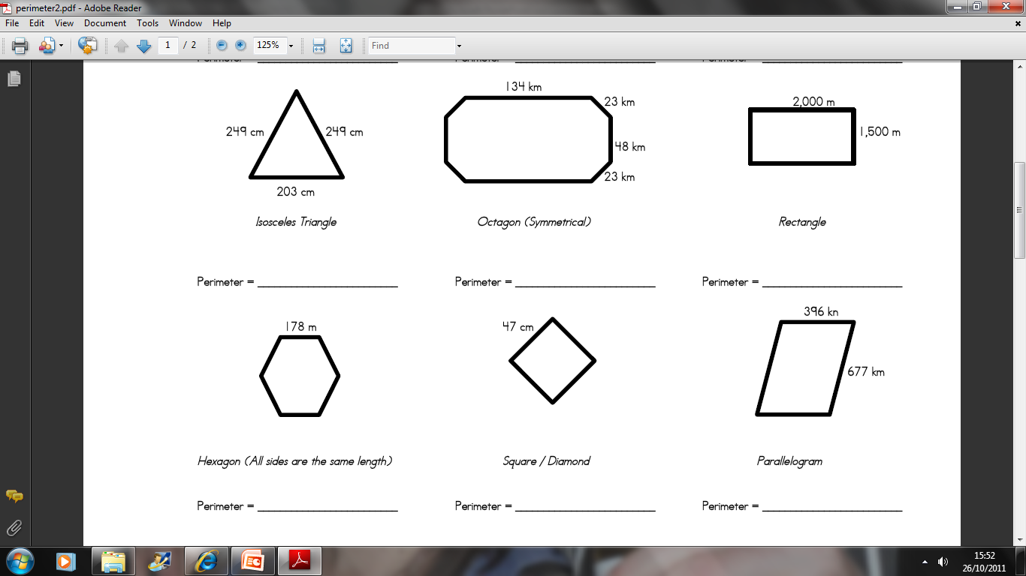
701cm
456km
7000m
1068m
188cm
2146cm

Slide 4
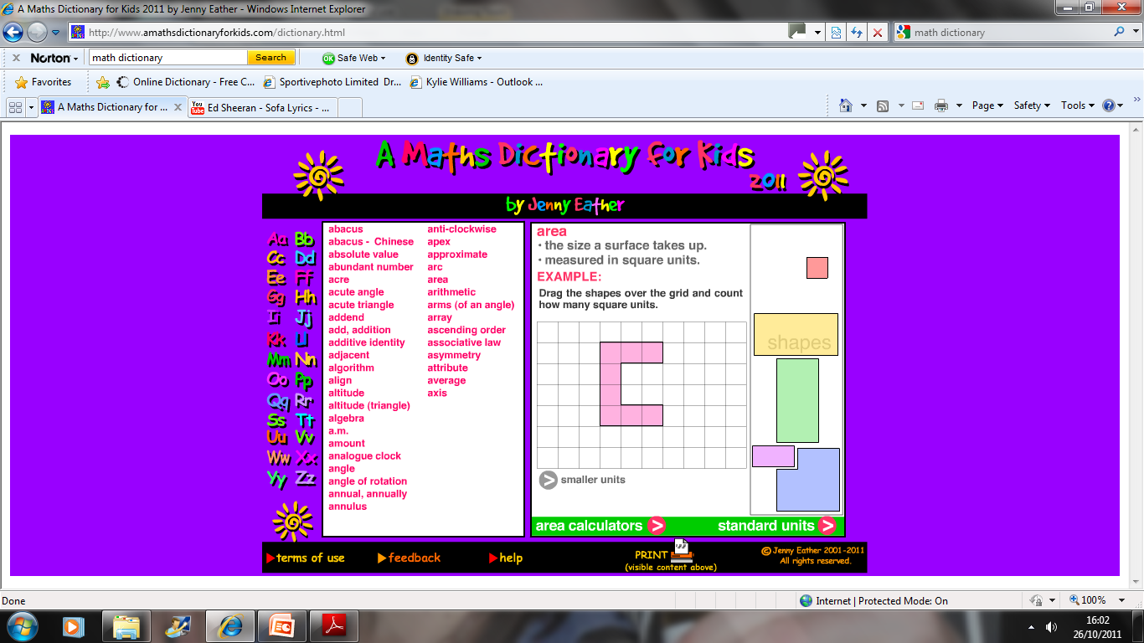
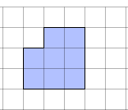
Area:The amount of space covered by a shape
Area is measured in square units

Slide 5
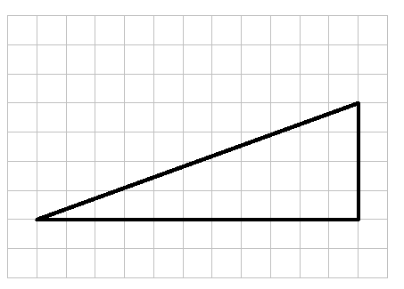

Slide 6
Area of a Rectangle
Area of a rectangle = length x width
6cm
3cm

Slide 7
3m
10cm
5cm
3cm
4cm
7m
4cm
15cm
104cm
3m

Slide 8
Area of a Triangle
Area of a Triangle = (base x height) ÷ 2
8cm
5cm
6cm
3cm

Slide 9
8cm
6cm
6cm
3cm
12cm
5cm
4cm
200cm
4m
5cm
3cm

Slide 10
Area of a Parallelogram
Area of Parallelogram = length x width
7cm
5cm

Slide 11
7cm
12cm
6cm
6cm
9cm
2cm
5m
53cm
100cm
30cm

Slide 12

Area of a Trapezium
3cm
6cm
7cm

Slide 13
5 cm
3 cm
8 mm
3 cm
4 mm
21 mm
6 mm
19 m
10 mm

Slide 14
Shapes
Formula
Square
Area of a rectangle = length X width
Triangle
Area of a Triangle = (base X height) ÷ 2
Parallelogram
Area of Parallelogram = length X width
Trapezium

