Slide 1
Distributed Systems
P. Sai Kiran
Notes:
This template can be used as a starter file for a photo album.

Slide 2
Distributed systems
Introduction

Slide 3
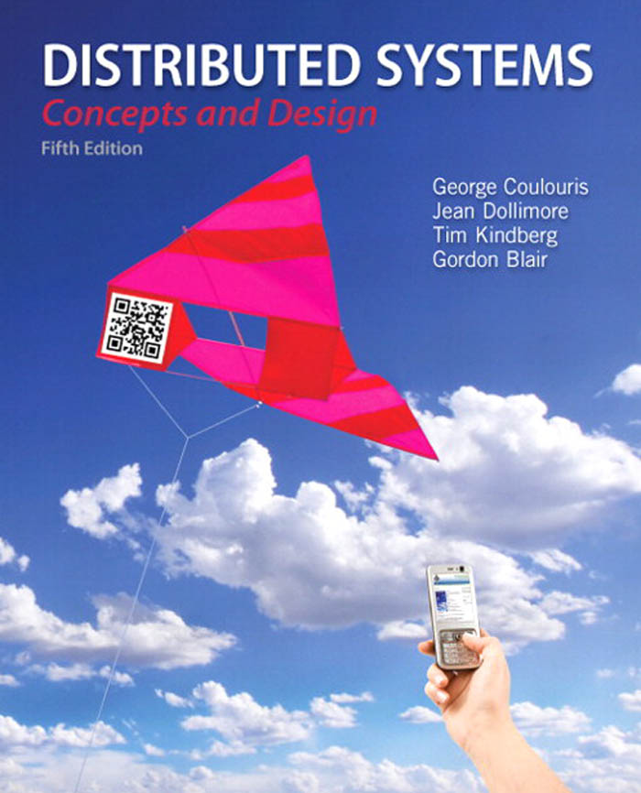
TEXT BOOK
Coulouris, Dollimore, Kindberg and Blair Distributed Systems: Concepts and Design
Edition 5, © Addison-Wesley 2012

Slide 4
Course Context & Overview
The course is designed to provide an in-depth understanding of the issues involved in designing and analyzing distributed systems.
The main objective of this course is to provide a solid foundation for understanding, analyzing and designing distributed algorithms for reliable distributed systems.
The course coverage includes an in-depth study of distributed system models, the importance of model selection, distributed process management, naming in distributed system, consistency and replication, fault tolerance and security.

Slide 5
Course Competencies
1 | Present a conceptual model of distributed systems
2 | Describes key components of a distributed system and evaluate the tradeoffs of alternative architectural models
3 | Suggest algorithm suitable for application in distributed systems
4 | Build prototype implementations of distributed systems
5 | Demonstrate an understanding of the challenges faced by future distributed systems
6 | Reason about distributed algorithms for locking, synchronization and concurrency, scheduling, and replication

Slide 6
Distributed Systems Definitions
A distributed system is a piece of software that ensures that a collection of independent computers appears to its users as a single coherent system
A distributed system is one in which components located at networked computers communicate and coordinate their actions only by passing messages.

Slide 7
Characters of Distributed System
Autonomous components (i.e., computers)
A single coherent system
The difference between components as well as the communication between them are hidden from users
Users can interact in a uniform and consistent way regardless of where and when interaction takes place
Easy to expand and replace
Notes:
Figure 1-1. A distributed system organized as middleware. The middleware layer extends over multiple machines, and offers each application the same interface.
Three characteristics
(1) differences between the various computers and the ways in which they communicate are mostly hidden from users.
(2) Users and applications can interact with a DS in a consistent and uniform way
(3) easy to expand or scale

Slide 8
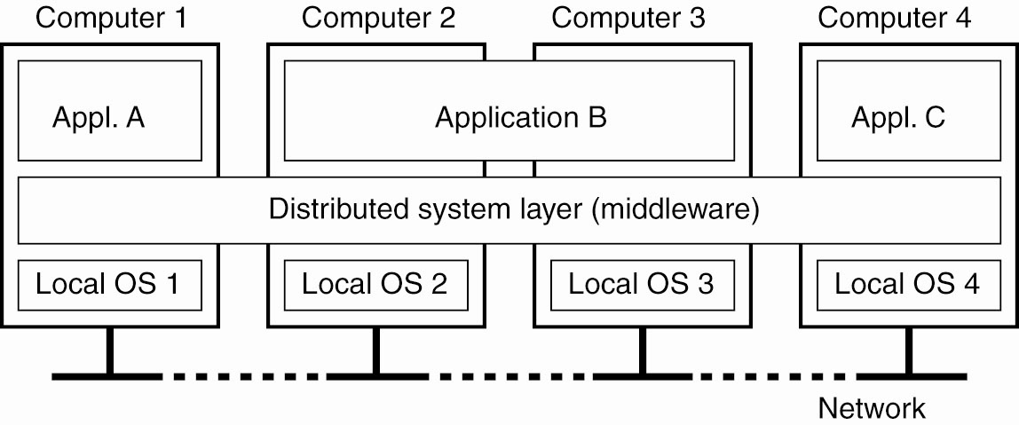
Distributed System as a Middleware
Notes:
Figure 1-1. A distributed system organized as middleware. The middleware layer extends over multiple machines, and offers each application the same interface.
Three characteristics
(1) differences between the various computers and the ways in which they communicate are mostly hidden from users.
(2) Users and applications can interact with a DS in a consistent and uniform way
(3) easy to expand or scale

Slide 9
Middleware Examples
CORBA (Common Object Request Broker Architecture)
DCOM (Distributed Component Object Management) – being replaced by .net
Sun’s ONC RPC (Remote Procedure Call)
RMI (Remote Method Invocation)
SOAP (Simple Object Access Protocol)

Slide 10
Middleware Examples
All of the previous examples support communication across a network:
They provide protocols that allow a program running on one kind of computer, using one kind of operating system, to call a program running on another computer with a different operating system
The communicating programs must be running the same middleware.

Slide 11
Benefits of Distributed Systems
Price/performance ratio
More computing power
More storage space
Pervasive computing
Increased reliability
Incremental growth
Remote services.

Slide 12
Applications
Finance and commerce | eCommerce e.g. Amazon and eBay, PayPal, online banking and trading
The information society | Web information and search engines, ebooks, Wikipedia; social networking: Facebook and MySpace.
Creative industries and entertainment | online gaming, music and film in the home, user-generated content, e.g. YouTube, Flickr

Slide 13
Applications
Healthcare | health informatics, on online patient records, monitoring patients
Education | e-learning, virtual learning environments; distance learning
Transport and logistics | GPS in route finding systems, map services: Google Maps, Google Earth
Science | The Grid as an enabling technology for collaboration between scientists
Environmental management | sensor technology to monitor earthquakes, floods or tsunamis

Slide 14
Design Goals
Resource accessibility
Easy to access and share resource
Distribution transparency
Hide the fact that resources are distributed across the network
Openness
The system should offer services according to standard rules that describe their syntax and semantics
Extensible: easy to add / replace components
Scalability
Size scalable, geographically scalable, administratively scalable

Slide 15
Resource Accessibility
Benefits
Economic, e.g., sharing costly devices such as printers and RAID
Encourage collaboration and exchange of information, e.g., Internet, Facebook, CVS version control
Problems
Security, e.g., eavesdropping connection, email spam, DDOS attacks

Slide 16
Distribution Transparency
Access transparency
Hide the difference in data representation and how a resource is accessed
Location transparency
Hide where a resource is physically located
Migration transparency
Hide that a resource may be moved to another location

Slide 17
Distribution Transparency
Relocation transparency
Hide that a resource may be moved during access
Replication transparency
Hide that a resource may be replicated at many locations
Concurrency transparency
Hide that a resource may be shared by several competitive users
Failure transparency
Hide the failure and recovery of a resource

Slide 18
Openness
Interoperability
Implementations from different manufacturers can work together by merely relying on the standard rules
Portability
Applications from one distributed system can be executed on another distributed system that implements the same service
Extensibility
Easy to add or replaces components in the system
Flexibility
Separating policy from mechanism

Slide 19
Scalability
Size scalable
Can easily add more users or resources to the system
Geographically scalable
Can easily handle users and resources that may lie far apart
Administratively scalable
Can easily manage the system even if it spans many independent administrative organizations

Slide 20
Types of Distributed Systems
Distributed Computing Systems
Cluster Computing
Grid Computing
Cloud Computing
Distributed Information Systems
Transaction Processing Systems
Enterprise Application Integration
Distributed Pervasive Systems
Home systems
Health care systems
Sensor networks

Slide 21
Cluster Computing
A collection of similar processors running the same operating system, connected by a high-speed LAN.
High Performance Clusters (HPC)
Load Balancing Clusters
High Availability Clusters (HA)

Slide 22
Grid Computing Systems
Highly heterogeneous with respect to hardware, software, networks, security policies, etc.
Grids support virtual organizations: a collaboration of users who pool resources (servers, storage, databases) and share them
Grid software is concerned with managing sharing across administrative domains.

Slide 23
Cloud Computing
Provides scalable services as a utility over the Internet.
Often built on a computer grid
Users buy services from the cloud
Grid users may develop and run their own software
Cluster/grid/cloud distinctions blur at the edges!
IAAS
PAAS
SAAS

Slide 24
Distributed Information Systems
Business-oriented
Systems to make a number of separate network applications interoperable and build “enterprise-wide information systems”.
Two types discussed here:
Transaction processing systems
Enterprise application integration (EAI)

Slide 25
Distributed Pervasive Systems
The first two types of systems are characterized by their stability: nodes and network connections are more or less fixed
This type of system is likely to incorporate small, battery-powered, mobile devices
Home systems
Electronic health care systems – patient monitoring
Sensor networks – data collection, surveillance

Slide 26
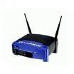
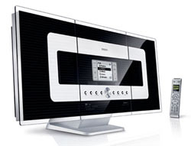
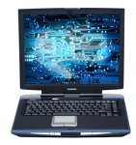
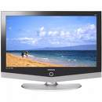
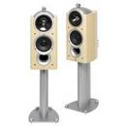
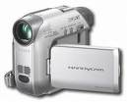
Home systems
WiFi
satellite
WiFi 802.11g
WiFi
UWB
bluetooth
WiFi
cellular

Slide 27
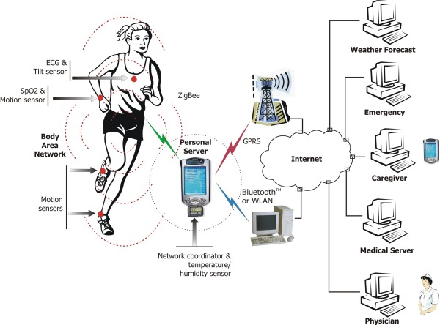
Electronic health care systems
Source: http://www.ece.uah.edu/~jovanov/whrms/

Slide 28
Sensor Networks
A collection of geographically distributed nodes consisting of a comm. device, a power source, some kind of sensor, a small processor…
Purpose: to collectively monitor sensory data (temperature, sound, moisture etc.,) and transmit the data to a base station
“smart environment” – the nodes may do some rudimentary processing of the data in addition to their communication responsibilities.

Slide 29
Summary – Types of Systems
Distributed computing systems – our main emphasis
Distributed information systems – we will talk about some aspects of them
Distributed pervasive systems – not so much

Slide 30
Challenges
Heterogeneity
Networks; computer hardware; operating systems; programming languages; implementations by different developers.
Middleware
Heterogeneity and mobile code
virtual machine
Openness
Security
Confidentiality, integrity, availability

Slide 31
Challenges
Scalability
Failure handling
Detecting failures: Masking failures: Tolerating failures : Recovery from failures: Redundancy:
Concurrency
For an object to be safe in a concurrent environment, its operations must be synchronized in such a way that its data remains consistent.
Transparency
Quality of service

Slide 32
Tutorial
Compare single system computing, client – server computing and distributed computing.
Consider the implementation strategies for massively multiplayer online games. In particular, what advantages do you see in adopting a single server approach for representing the state of the multiplayer game? What problems can you identify and how might they be resolved?
Consider WWW as an case study of distributed system and give a detailed write-up about it.

