Slide 1
Networking and Open Source Software
Maximum Marks : 10
No. of teaching periods : 10

Slide 2
Evolution of Networking
ARPANET ( A network between DOD and Universities)

Slide 3
Internet & Interspace
Internet is a network of networks
Interspace is a client/server software program that allows multiple users to communicate online with real-time audio, video and text chat in dynamic 3D environments. Interspace provides the most advanced form of communication available on the Internet today.

Slide 4
Internet & Interspace
The Interspace is a vision of what the Internet will become, where users cross-correlate information in multiple sources. It is an applications environment for interconnecting spaces to manipulate information, much as the Internet is a protocol environment for interconnecting networks to transmit data.

Slide 5
Different ways of sending data across network
Circuit Switching
Message Switching
Packet Switching

Slide 6
Data Communication Terminology - Baud
Baud - is synonymous to symbols per second or pulses per second. It is the unit of symbol rate, also known as baud rate or modulation rate; the number of distinct symbol changes (signaling events) made to the transmission medium per second in a digitally modulated signal or a line code.
Bandwidth
Data Transfer Rate

Slide 7
Data Communication Terminology - Bandwidth
In computer networking and computer science, the words bandwidth,network bandwidth,data bandwidth,or digital bandwidth are terms used to refer to various bit-rate measures, representing the available or consumed data communication resources expressed in bits per second or multiples of it (bit/s, kbit/s, Mbit/s, Gbit/s, etc.).

Slide 8
Data Communication Terminology – Data Transfer Rate
Home > data transfer rate data transfer rate
The speed with which data can be transmitted from one device to another. Data rates are often measured in megabits (million bits) or megabytes (million bytes) per second. These are usually abbreviated as Mbps and MBps, respectively.
Another term for data transfer rate is throughput.

Slide 9
Data Communication terminologies
Concept of Channel and Data transfer rate (bps, kbps, Mbps, Gbps, Tbps)
The data transfer rate is commonly used to measure how fast data is transferred from one location to another. For example, a hard drive may have a maximum data transfer rate of 480 Mbps, while your ISP may offer an Internet connection with a maximum data transfer rate of only 1.5 Mbps.

Slide 10
Data Transfer Rate
World's Fastest Internet Speed: 186 Gbps Data Transfer Sets New Record
3G telecommunication networks support services that provide an information transfer rate of at least 200 kbit/s.
airtel 3G USB modem 7.2 Mbps – E1731

Slide 11
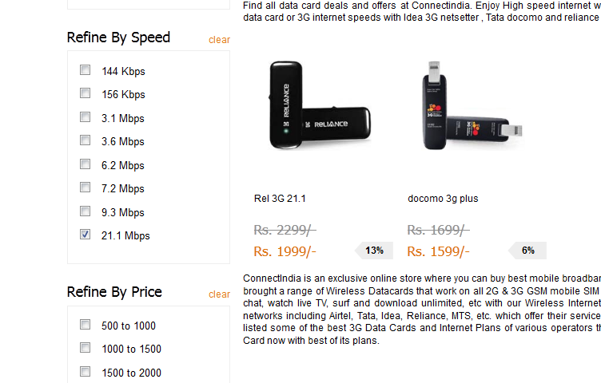

Slide 12
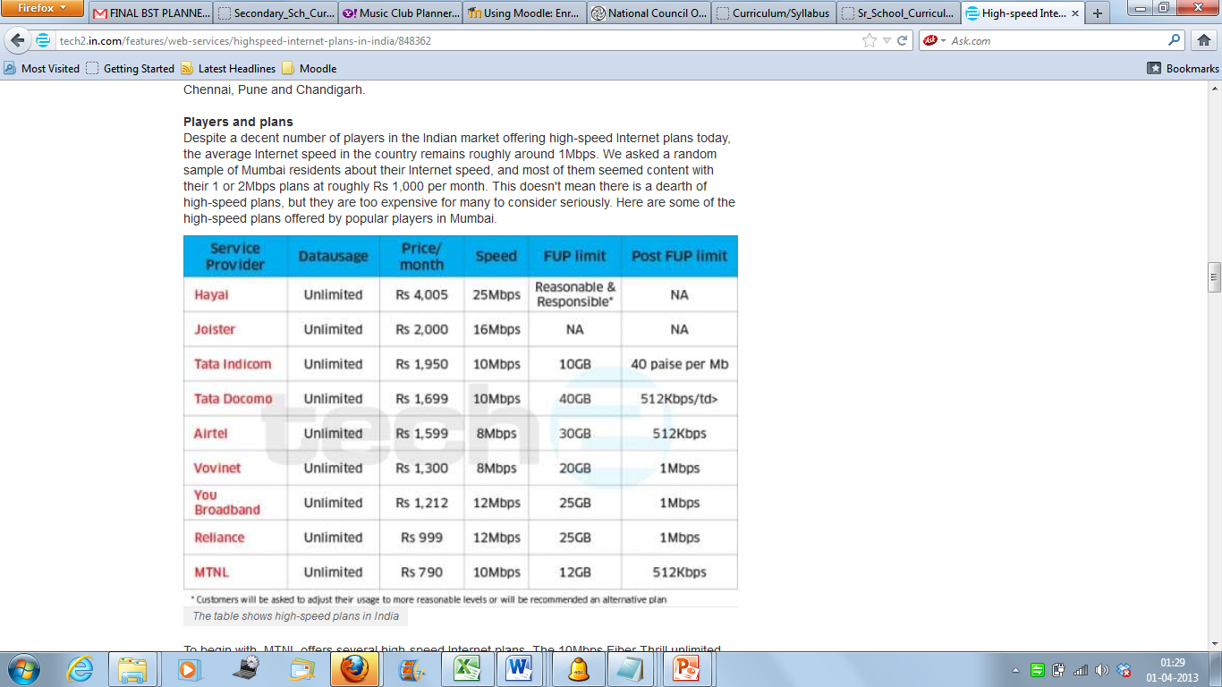

Slide 13
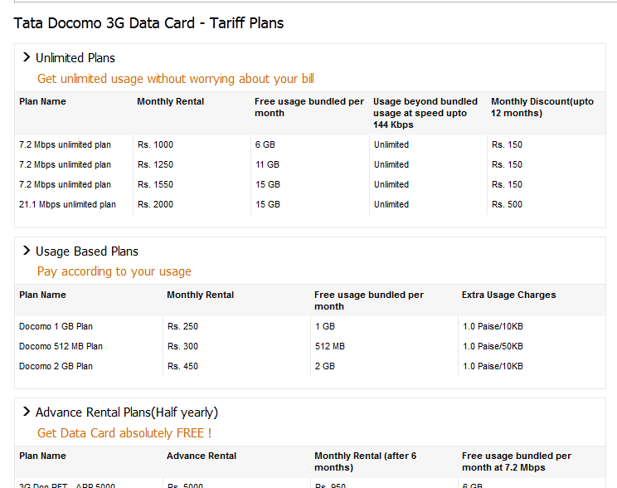

Slide 14
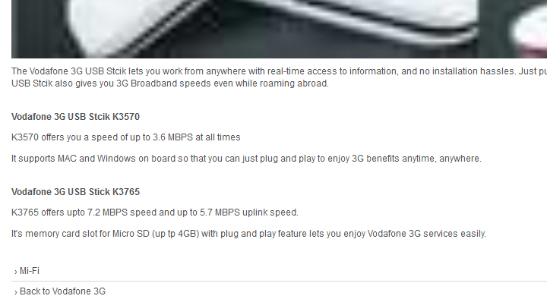

Slide 15
Airtel – set for 4G
Kolkata/New Delhi, April 10:
After Kolkata, Bharti Airtel will take its fourth generation (4G) technology-based broadband service to Bangalore in the next 30 days.
This will be followed by similar rollouts in Pune and Chandigarh.
4G technology enables users to access wireless broadband services at 30-40 Mbps speeds compared to 3-4 Mbps on 3G platform.
Airtel on Tuesday became the first telecom company in the country to roll out its 4G-based services in Kolkata. The new technology will allow high speed internet services that include high definition video streaming and instant photo and video downloads.

Slide 16
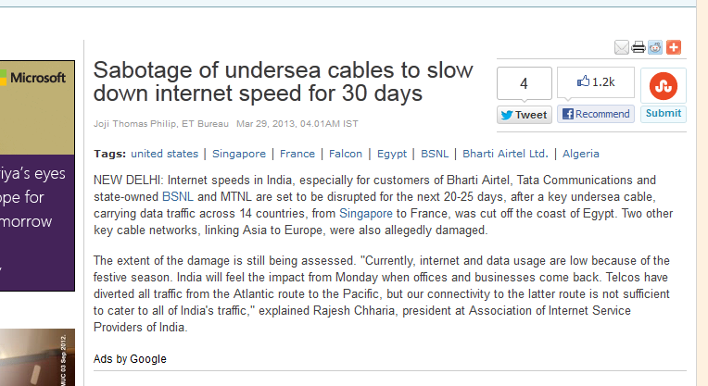

Slide 17
KBps & Kbps
The difference between KBps (KB/s) and kbps (kb/s) is that
1 KBps (1 KB/s) = 1024 bytes per second
while
1 kbps (1 kb/s) = 1000 bits per second
In other words, 1 KBps is around 8 times faster than 1 kbps. This is because 1 byte=8 bits.

Slide 18
Transmission media:
Twisted pair cable
coaxial cable
optical fiber
infrared
radio link
microwave
link and
satellite link

Slide 19
Twisted Pair Cable
Unshielded Twisted Pair (UTP)
Cable Shielded Twisted Pair (STP) Cable
Unshielded twisted pair (UTP) is the most popular and is generally the best option for school networks
They may be susceptible to radio and electrical frequency interference

Slide 20
Twisted Pair Cable
The quality of UTP may vary from telephone-grade wire to extremely high-speed cable. The cable has four pairs of wires inside the jacket. Each pair is twisted with a different number of twists per inch to help eliminate interference from adjacent pairs and other electrical devices. The tighter the twisting, the higher the supported transmission rate and the greater the cost per foot.

Slide 21
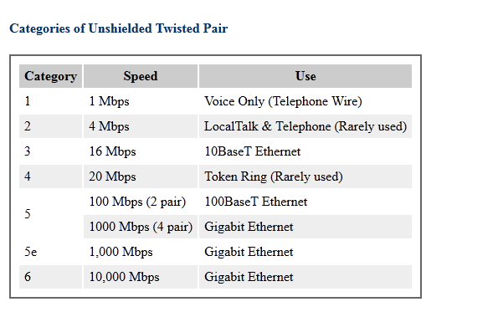
Twisted Pair Cable

Slide 22
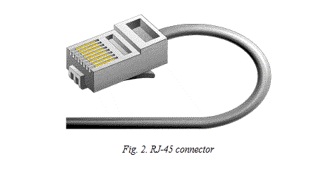
Unshielded twisted pair cable
The standard connector for unshielded twisted pair cabling is an RJ-45 connector. This is a plastic connector that looks like a large telephone-style connector

Slide 23
Shielded Twisted Pair Cable
Shielded twisted pair cable is available in three different configurations:
Each pair of wires is individually shielded with foil.
There is a foil or braid shield inside the jacket covering all wires (as a group).
There is a shield around each individual pair, as well as around the entire group of wires (referred to as double shield twisted pair).

Slide 24
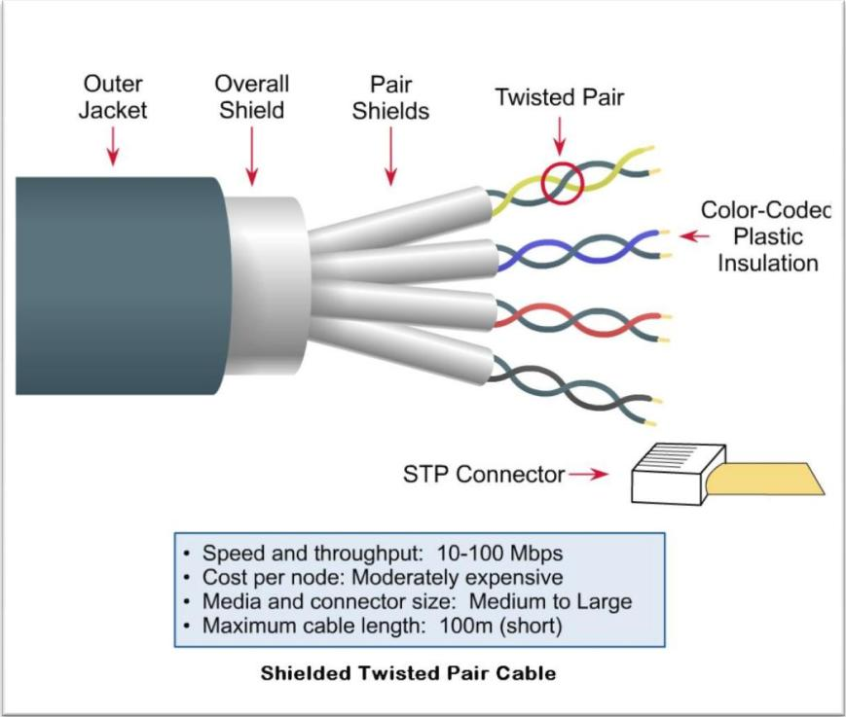
STP

Slide 25

Coaxial Cables
Coaxial cabling has a single copper conductor at its center. A plastic layer provides insulation between the center conductor and a braided metal shield . The metal shield helps to block any outside interference from fluorescent lights, motors, and other computers.

Slide 26
Coaxial Cable
Although coaxial cabling is difficult to install, it is highly resistant to signal interference. In addition, it can support greater cable lengths between network devices than twisted pair cable. The two types of coaxial cabling are thick coaxial and thin coaxial.

Slide 27

Coaxial Cable Connector
The most common type of connector used with coaxial cables is the Bayone-Neill-Concelman (BNC) connector

Slide 28
Fiber Optic Cable
Fiber optic cabling consists of a center glass core surrounded by several layers of protective materials
It transmits light rather than electronic signals eliminating the problem of electrical interference.
This makes it ideal for certain environments that contain a large amount of electrical interference. It has also made it the standard for connecting networks between buildings, due to its immunity to the effects of moisture and lighting.

Slide 29

Fiber Optic Cable

Slide 30
Fiber Optic Cable
Fiber optic cable has the ability to transmit signals over much longer distances than coaxial and twisted pair.
It also has the capability to carry information at vastly greater speeds. This capacity broadens communication possibilities to include services such as video conferencing and interactive services.
The cost of fiber optic cabling is comparable to copper cabling; however, it is more difficult to install and modify.

Slide 31
Unguided Media
Transports electromagnetic waves without using a physical conductor
This is often referred to as wireless communication
It includes propagation through ground, sky or line of sight

Slide 32
Wireless LANS
Use high frequency radio signals, infrared light beams or laser to communicate
Standard | Max Speed | Typical Range
802.11 a | 54 Mbps | 150 feet
802.11b | 11 Mbps | 300 feet
802.11g | 54 Mbps | 300 feet

Slide 33
Commonly used wireless networks
Infrared
Radio link
Microwave link
Satellite link

Slide 34
Infrared
Can be used for short range communication
Line of sight
Used in home remotes, cordless devices, intrusion detection
They cannot penetrate through walls
Fairly reliable
Don’t cost very much

Slide 35
Infrared – Advantages
Low power requirements (ideal for laptops, phones)
Low circuitry cost
Higher security ( Directionality of beam helps ensure that data is not leaked)
High noise immunity

Slide 36
Infrared - Disadvantages
Line of sight
Short range
Light, weather sensitive
Speed is low as compared to other wired transmissions
Almost always one to one technology

Slide 37
Microwave link
Very short wavelength
Microwave signals can be focused by antennas into a narrow beam
Any information that can travel on wires can be transmitted through microwaves

Slide 38
Microwave - Advantages
Cheaper than laying cables
Provides high transfer rates
Small antennas required

Slide 39
Microwave - Disadvantages
Line of sight
Signal absorption by atmosphere. Microwaves suffer attenuation due to atmospheric conditions
Towers are expensive to build.
Transmitting and receiving antennas need to be properly aligned as signal travel in straight line

Slide 40
Radio Link
Like visible light, infrared, ultraviolet, X-rays and gamma rays are electromagnetic waves
Transmitter at radio station converts sound waves to electromagnetic waves which are then encoded onto an electromagnetic wave in the radio frequency range.
( 500 – 1600 kHz for AM stations)
86 – 107 MHz for FM stations

Slide 41
Radio link
Radio electromagnetic waves can travel very long distances without being greatly attenuated
Your radio receives these radio waves, decodes information and uses speakers to change it back to sound wave

Slide 42
Radio link
Have longer wavelength
Can penetrate through obstacles
Carry lesser energy

Slide 43
Radio Waves
Easy to generate
Travel over long distances
Can penetrate through buildings
Waves are omni directional
Relatively inexpensive than wired mediums

Slide 44
Radio Waves
Signal frequency dependent
Less secure mode of transmission
At lower frequency, signal pass through obstacles and power falls off

Slide 45
Satellite link
Uses the communication of the satellite in space with large number of earth stations on the ground
Signals are transmitted to the satellite through dish antennas. (Uplink)
The signals are then received by antennas and recd by the users

Slide 46
Satellite - Advantages
Transmission from any location on earth
Higher bandwidth are available for use

Slide 47
Satellite - Disadvantages
Launching satellites into orbits is costly
Satellite bandwidth is gradually becoming used up
There is larger propagation delay in satellite communication than any other

Slide 48
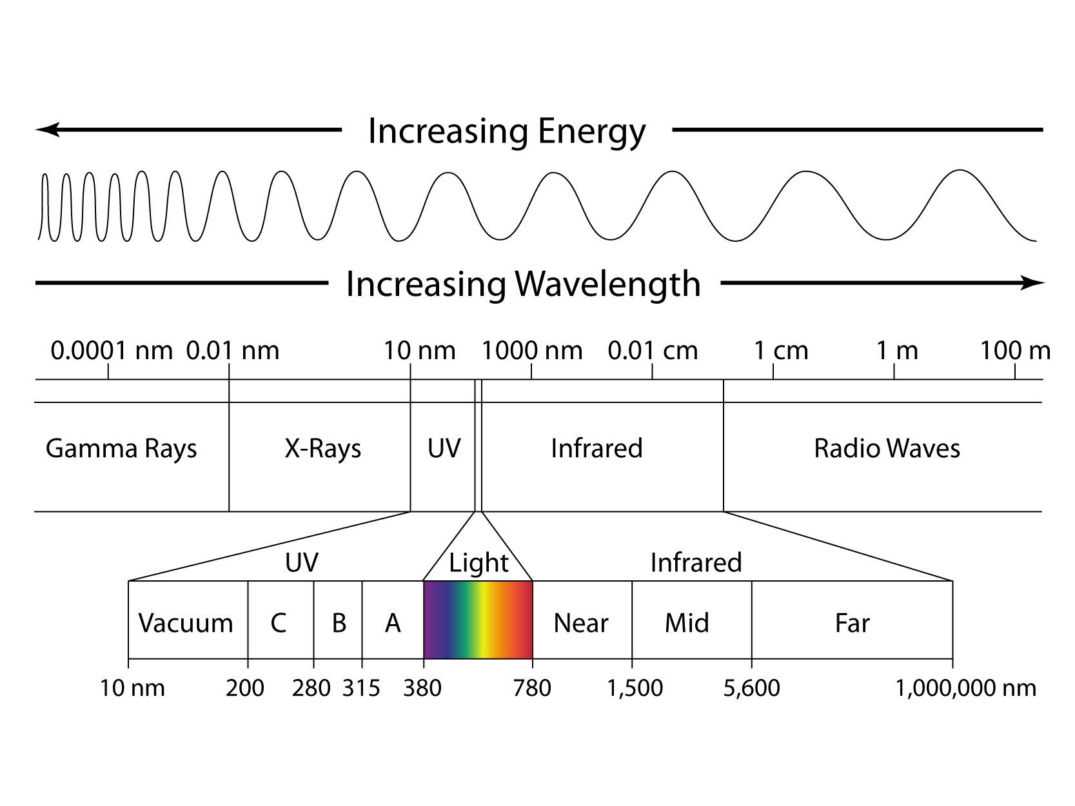

Slide 49
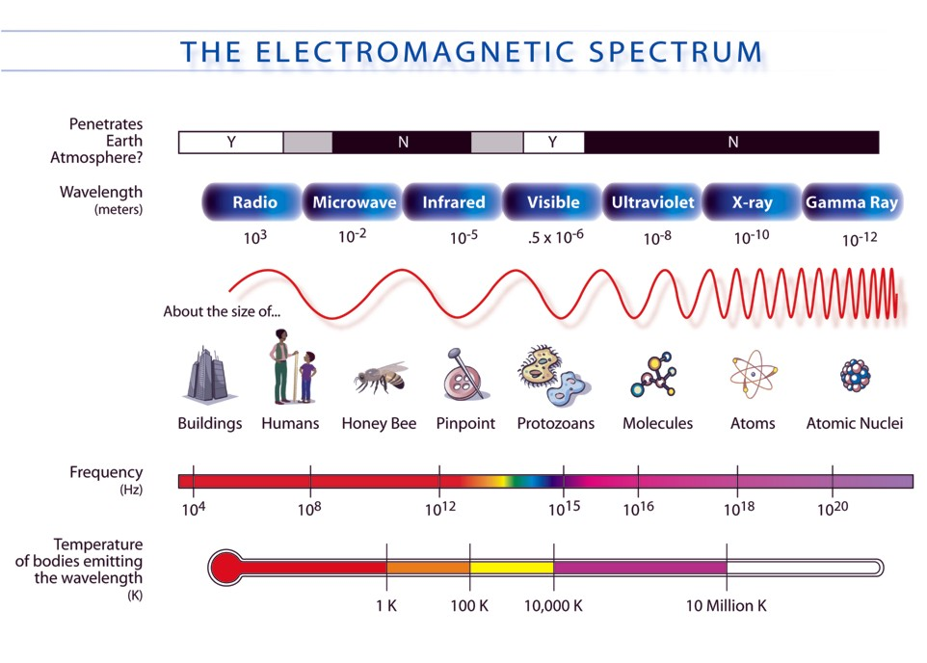

Slide 50
Network devices:
Modem
RJ11and RJ45 connectors
Ethernet Card
Hub
Switch
Gateway

Slide 51
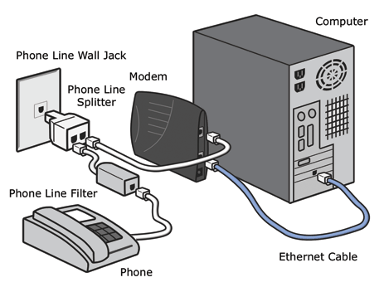
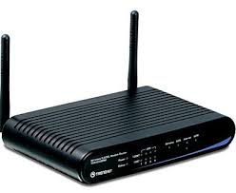
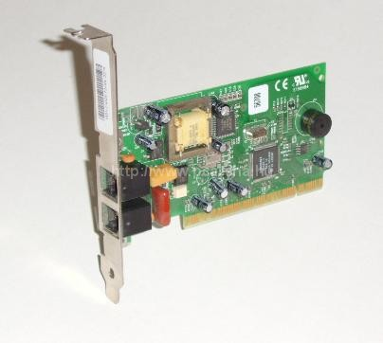
Network devices:
Modem

Slide 52
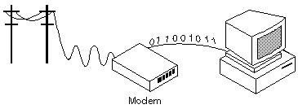
Network Devices - Modem
Short for modulator-demodulator. A modem is a device or program that enables a computer to transmit data over, for example, telephone or cable lines. Computer information is stored digitally, whereas information transmitted over telephone lines is transmitted in the form of analog waves. A modem converts between these two forms.

Slide 53
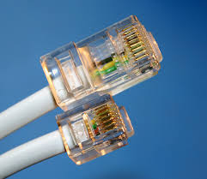
Network devices:
RJ11and RJ45 connectors
1.RJ45 is used with ethernet cables in computer networking while RJ11 is used in connecting telephone units
2.RJ45 contains more wires than RJ11
3.RJ45 is physically bigger than RJ11 to accommodate the extra wires

Slide 54
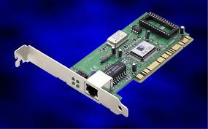
Network devices : Ethernet Card

Slide 55
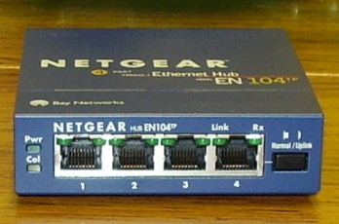
Network Devices : Hub
An Ethernet hub, active hub, network hub, repeater hub, multiport repeater or hub is a device for connecting multiple Ethernet devices together and making them act as a single network segment. It has multiple input/output (I/O) ports, in which a signal introduced at the input of any port appears at the output of every port except the original incoming.

Slide 56
Network Devices : Switch
A network switch is a small hardware device that joins multiple computers together within one local area network (LAN).
Network switches appear nearly identical to network hubs, but a switch generally contains more intelligence (and a slightly higher price tag) than a hub.
Unlike hubs, network switches are capable of inspecting data packets as they are received, determining the source and destination device of each packet, and forwarding them appropriately.
By delivering messages only to the connected device intended, a network switch conserves network bandwidth and offers generally better performance than a hub.

Slide 57
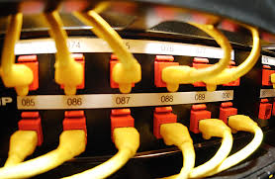
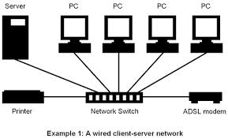
Network Devices : Hub

Slide 58
Network Devices : Gateways
In a communications network, a network node equipped for interfacing with another network that uses different protocols.
A gateway may contain devices such as protocol translators, matching devices, rate converters, fault isolators, or signal translators as necessary to provide system interoperability. It also requires the establishment of mutually acceptable administrative procedures between both networks.

Slide 59
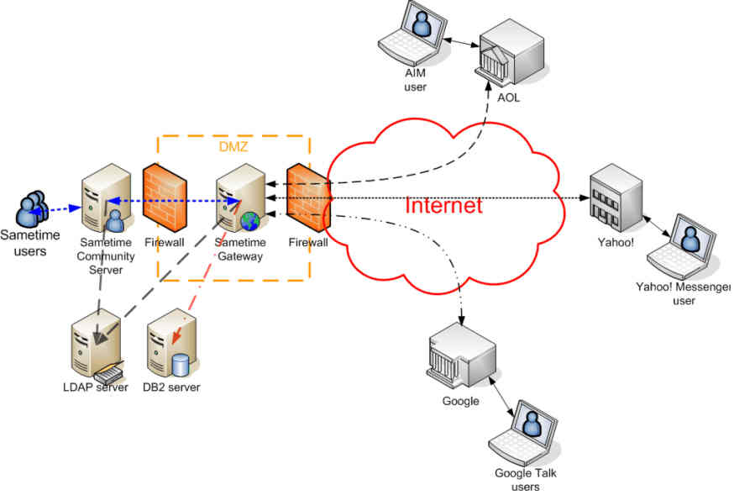
Gateway

Slide 60
Network Topologies and types:
Topologies :
Bus, Star, Tree
Types of network :
PAN, LAN, WAN, MAN

Slide 61
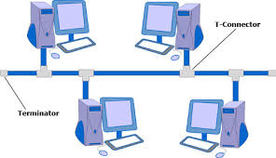
Bus Topology
Ease of installation.
Simple and cheap.
If one computer fails it does not affect the other computers.
Minimizing the amount cable used connecting the network.

Slide 62
Bus Topology
If the main cable fails, all the other sources will die
Terminators are required at both ends
At a time only one node can transfer data
Difficult to identify the problem if the entire network shuts down

Slide 63
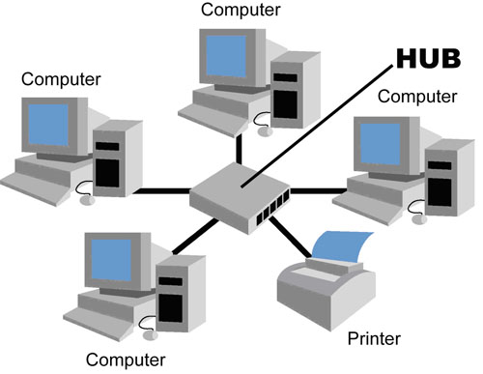
Star Topology

Slide 64
Star Topology
Star networks : A star network consists of one central switch, hub or computer, which acts as a conduit(duct/tube/pipe/channel) to transmit messages. This consists of a central node, to which all other nodes are connected; this central node provides a common connection point for all nodes through a hub.

Slide 65
Star
Easy to manage
If a problem occurs in the network, it can be isolated and cleared
Easy to extend
No collision of data

Slide 66
Star
Complete dependence on hub
Network connection may slow down when the number of nodes increases or the cable lengthens
Star topology needs more cable length
More expensive than bus

Slide 67
Star
High dependence of the system on the functioning of the central hub.
Failure of the central hub renders the network inoperable

Slide 68
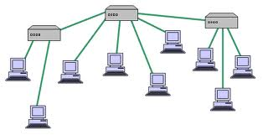
Tree

Slide 69
Tree
It is possible to form a point to point connection with tree topology
All computers can access other computers which are in other larger and immediate network

Slide 70
Tree
Entire tree topology would fail if the central truck fails
More complex . As it grows it becomes difficult to manage
It is expensive as more hubs and cables are required

Slide 71
Network Protocols
Include guidelines that regulate –
Access methods
Allowed physical topologies
Type of cabling
Speed of data transfer
They can be implemented in hardware or software

Slide 72
Network Protocol:
TCP/IP, File Transfer Protocol (FTP), PPP, Remote Login (Telnet), Internet
Wireless/Mobile Communication protocol such as GSM, CDMA, GPRS, WLL,
Mobile Telecommunication Technologies : 1G, 2G, 3G and 4G
Electronic mail protocols such as SMTP, POP3
Protocols for Chat and Video Conferencing VOIP
Wireless protocols such as Wi-Fi and WiMax

Slide 73
TCP/IP
Main protocol for communication on internet
TCP for breaking & assembling data
IP responsible for sending packets to correct destination – it decides the route

Slide 74
File Transfer Protocol
Enables file sharing between hosts

Slide 75
PPP
Point to Point Connection is a private data connection securely connecting two or more locations for private data services. A point to point connection is a closed network data transport service which does not traverse the public Internet and is inherently secure with no data encryption needed.

Slide 76
PPP
An example is a telephone call, in which one telephone is connected with one other, and what is said by one caller can only be heard by the other. This is contrasted with a point-to-multipoint or broadcast communication topology,

Slide 77
Remote Login (Telnet)
TELNET is used for remote login to other computers on the Internet.
Telnet is a network protocol used on the Internet or local area networks to provide a bidirectional interactive text-oriented communication facility
Not secure
The tlntadmn commands allow you to remotely manage a computer running Telnet Server. These commands are run from the command prompt. Used without parameters, tlntadmn displays local server settings.
Telnet clients – Microsoft, Unix

Slide 78
Telnet
To use telnet commands at the Telnet prompt
To start Telnet Client and to enter the Telnet prompt
Syntax
telnet [\\RemoteServer]

Slide 79
Internet Protocol
The Internet Protocol (IP) is the principal communications protocol in the Internet protocol suite for relaying datagrams across network boundaries. Its routing function enables internetworking, and essentially establishes the Internet.

Slide 80
Technologies used in cellular phones
3 main technologies
GSM
TDMA
CDMA

Slide 81
CDMA
An analogy to the problem of multiple access is a room (channel) in which people wish to talk to each other simultaneously. To avoid confusion, people could take turns speaking (time division), speak at different pitches (frequency division), or speak in different languages (code division).
CDMA is analogous to the last example where people speaking the same language can understand each other, but other languages are perceived as noise and rejected.
Similarly, in radio CDMA, each group of users is given a shared code. Many codes occupy the same channel, but only users associated with a particular code can communicate.

Slide 82
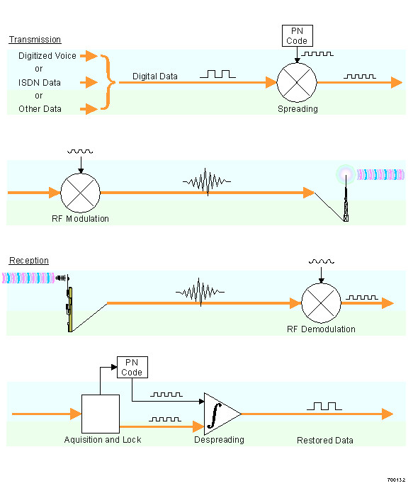

Slide 83
CDMA
CDMA does not assign a specific frequency to each user.
Instead, every channel uses the full available spectrum.
Individual conversations are encoded with a pseudo-random digital sequence.
CDMA consistently provides better capacity for voice and data communications than other commercial mobile technologies, allowing more subscribers to connect at any given time, and it is the common platform on which 3G technologies are built.

Slide 84
Frequency Hopping Spread Spectrum
An Example of a Co-located Frequency Hopping System

Slide 85
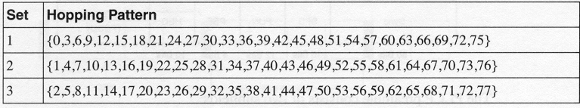
Frequency hopping
  The hopping channels for the US and Europe are shown below.
Dwell time per frequency is around 100 ms

Slide 86
GSM
Operates at either 900 MHz 0r 1800 MHz frequency band
Was first launched in Finland in 1991
Today, 690 mobile networks provide GSM services over 213 countries
GSM represents 82.4% of all global mobile connections

Slide 87
GSM
Many GSM network operators have roaming agreements with foreign countries
GSM is also known as 2 G technology
Mature and stable technology
Consistent service

Slide 88
GSM
Has pulse nature which can interfere with some electronic devices including pace makers, hearing aids
That is why hospitals require you to turn off cell phones
GSM uses TDMA (Time division multiple access)

Slide 89
CDMA & GSM
For call quality, the technology you use is much less important than the way your carrier has built its network. There are good and bad CDMA and GSM networks, but there are key differences between the technologies.

Slide 90
CDMA & GSM
It's much easier to swap phones on GSM networks, because GSM carriers put customer information on a removable SIM card. Take the card out, put it in a different phone, and the new phone now has your number. What's more, to be considered GSM, a carrier must accept any GSM-compliant phone. So the GSM carriers don't have total control of the phone you're using.

Slide 91
Wireless/Mobile Communication protocol GPRS, WLL
GPRS
General packet radio service (GPRS) is a packet oriented mobile data service on the 2G and 3G cellular communication system's global system for mobile communications (GSM).
promises data rates from 56 up to 114 Kbps and continuous connection to the Internet for mobile phone and computer users.

Slide 92
GPRS
General Packet Radio Services (GPRS) is a packet-based wireless communication service that promises data rates from 56 up to 114 Kbps and continuous connection to the Internet for mobile phone and computer users.

Slide 93
WLL
WLL stands for Wireless Local Loop and it is basically the use of radio to provide a telephone connection to the home. It is sometimes called radio in the loop (RITL) or fixed-radio access (FRA).

Slide 94
WLL
When WLL connects subscribers to the public switched telephone network (PSTN), radio signals are used as a substitute for copper for all or part of the connection between the subscriber and the switch. Included in this is: cordless access systems, proprietary fixed radio access, and fixed cellular systems.

Slide 95
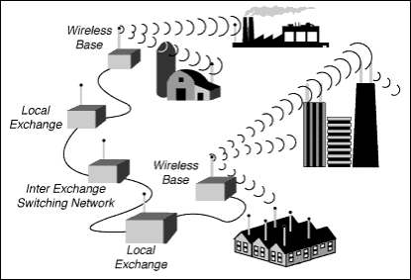

Slide 96
Mobile Telecommunication Technologies : 1G, 2G, 3G and 4G
1 G:
used in the first mobile phones.
Used analog radio signals
Was introduced in 1980s & continued till 1992
Eg. AMPS(Advanced Mobile Phone Systems)
CDPD (Cellular Digital Packet Data)

Slide 97
2G
Came in 1992
Used digital format
Introduced text messaging
Introduced data services for mobiles starting with SMS
Eg GSM, Digital AMPS, CDMA

Slide 98
3 G
More efficient ways of carrying data
Faster web services – live chats, fast downloading, video conferencing etc. on mobile phones
Introduced by DoCoMo

Slide 99
4 G
High quality streaming video and anytime, anywhere
Anytime where is called MAGIC (Mobile multimedia: Anytime/Anywhere; Global mobility support; Integrated wireless solution, Customized personal services)
Totally wireless
Data transmission at much higher rate

Slide 100
Electronic mail protocol
SMTP
Users receive and send email using
Simple Mail Transfer Protocol

Slide 101
Electronic mail protocol
POP3 & IMAP
Post Office Protocol allow users to retrieve and store mail messages

Slide 102
Protocols for Chat and Video Conferencing VOIP
A technology that allows you to make calls using broadband Internet Connection. (Voice Over Internet Protocol)
Converts your voice signals into digital that travels over the internet

Slide 103
Wireless protocol - WiFi
WiFi – Wireless fidility
Allows an electronic device to exchange data wirelessly (using radio waves) over a computer network, including high-speed Internet connections.
A device that can use Wi-Fi (such as a personal computer, video-game console, smartphone,digital camera tablet, or digital audio player)
can connect to a network resource such as the Internet via a wireless network access point. Such an access point (or hotspot) has a range of about 20 meters (65 feet) indoors and a greater range outdoors

Slide 104
Wireless protocol - WiMax
WiMAX (Worldwide Interoperability for Microwave Access) is a wireless communications standard designed to provide 30 to 40 megabit-per-second data rates

Slide 105
WiMax & WiFi Compared
WiMax has greater range
When multiple users connect to WiFi there is a constant battle for broadband access while with WiMax each user has constant broadband access
WiMax algorithm limits the number of users to connect to WiMax access point, if more try they are redirected to another access point

Slide 106
Network Security Concept
Network Security Concepts:
Threats and prevention from Viruses, Worms, Trojan horse, Spams
Use of Cookies, Protection using Firewall;
India IT Act, Cyber Law, Cyber Crimes, IPR issues, Hacking.

Slide 107
Threats and prevention from Viruses, Worms, Trojan horse, Spams

Slide 108
Use of Cookies, Protection using Firewall;

Slide 109
India IT Act, Cyber Law, Cyber Crimes, IPR issues, Hacking.

Slide 110
Web Services
WebServices:
WWW, Hyper Text Markup Language (HTML), eXtensible Markup Language (XML); Hyper Text
Transfer Protocol (HTTP); Domain Names; URL; Protocol Address; Website, Web browser, Web
Servers; Web Hosting, Web Scripting - Client side (VB Script, Java Script, PHP) and Server side
(ASP, JSP, PHP), Web 2.0 (for social networking)

Slide 111
HTML & XML
HTML => Hyper Text Markup Language
XML => Extensible Markup Language
HTML => Use only Predefined Tags
XML => Users must create their own tags
HTML => Not Case Sensitive Example : HTML as start tag and html as end tag are accepted.
XML => Case Sensitive Example: BOOKS as start tag and Books as end tag are not accepted
HTML => For displaying data (presentation language)
XML => For describing data
HTML => Static (Content is not changed every time page is reloaded)
XML => Dynamic (Content is changed every time page is reloaded)
HTML => Every tag need not having an end tag.
XML => Every tag must have an end tag.

Slide 112
HTML & XML
Hypertext Markup Language (HTML) is a page description language used on the World Wide Web that defines the hypertext links between documents.
Extensible Markup Language (XML) is an outgrowth of HTML, it is a markup language that allows data to be stored in a human readable format. The language also allows users to create unique tags or other elements.

Slide 113
HTTP
HTTP is the foundation of data communication for the World Wide Web.
Hypertext is a multi-linear set of objects, building a network by using logical links (the so-called hyperlinks) between the nodes (e.g. text or words). HTTP is the protocol to exchange or transfer hypertext.

Slide 114
DOMAIN NAME
Domain names are used to identify one or more IP addresses. For example, the domain name microsoft.com represents about a dozen IP addresses. Domain names are used in URLs to identify particular Web pages. For example, in the URL http://www.pcwebopedia.com/index.html, the domain name is pcwebopedia.com. `

Slide 115
URL
A uniform resource locator, abbreviated URL, also known as web address, is a specific character string that constitutes a reference to a resource. In most web browsers, the URL of a web page is displayed on top inside an address bar.
Eg.
http://www.kiitworld.in

Slide 116
Protocol Address
An Internet Protocol address (IP address) is a numerical label assigned to each device (e.g., computer, printer) participating in a computer network that uses the Internet Protocol for communication. An IP address serves two principal functions: host or network interface identification and location addressing

Slide 117
Protocol Address
IP addresses are binary numbers, but they are usually stored in text files and displayed in human-readable notations, such as 172.16.254.1

Slide 118
Website
Web browser – IE, FIREFOX
Web Servers – APACHE, IIS
Scripting :
Web Scripting - Client side (VB Script, Java Script, PHP)
Server side(ASP, JSP, PHP)

Slide 119
Web 2.0 (for social networking)
- A Web 2.0 site may allow users to interact and collaborate with each other in a social media dialogue as creators of user-generated content in a virtual community
Examples of Web 2.0 include social networking sites, blogs, wikis, video sharing sites,

Slide 120
Web hosting
Web Hosting - A web hosting service is a type of Internet hosting service that allows individuals and organizations to make their website accessible via the World Wide Web. Web hosts are companies that provide space on a server owned or leased for use by clients

Slide 121
Open Standards
Open Standards
Introduction to open standards and its advantage in development of inter-operable environment.

Slide 122
Open Source Concepts
Proprietary
Privately owned or controlled
Source Code is generally kept secret
A compiled version is given to the user
Such products are legal
User does not have the ability to study and modify
Cannot be copied & provided to 3rd parties
User cannot make and release improvements

Slide 123
Open Source Software

Slide 124
Freeware
IS distributed free by the author
Although it is available for free but the author retains the copyright
It cannot be altered or sold

Slide 125
Shareware
Shareware is distributed freely but with certain conditions
It is distributed free on trial basis with the understanding that the user may have to pay later

Slide 126
FLOSS/FOSS
Free/Liberal/Open/Source/Software
The term is used for free software and open source where free means cost free software.
Liberal means liberty to change
Code or patch files are available openly to fix the bugs and for further development

Slide 127
GNU
It is a computer operating system composed entirely of free software. It’s name is a recursive acronym for GNU’s Not Unix which was chosen because it resembled Unix code.

Slide 128
FSF
Free Software Foundation was established in 1985 to promote the development of free software with full rights to use, study, copy, modify and redistribute computer program.

Slide 129
OSI
Open Source Initiative
Is a non- profit organisation dedicated to managing and promoting Open Source Definition for good of the community
Linux, Firfox, Apache HTTP Server, MYSQL, POSTGRESQL, PANGO,PHP. PHYTHON, TOMCAT, OPENOFFICE are examples of Open Source Software

Slide 130
W3C
W3C Stands for the World Wide Web Consortium
W3C was created in October 1994
W3C was created by Tim Berners-Lee
W3C is working to Standardize the Web
W3C creates and maintains WWW Standards
W3C Standards are called W3C Recommendations

Slide 131
W3C
Some well known members are:
IBM
Microsoft
America Online
Apple
Adobe
Macromedia
Sun Microsystems

Slide 132
W3C
Does development of Web specifications (called "Recommendations") that describe communication protocols (like HTML and XML)

Slide 133
Cloud Computing
Cloud Computing
Characteristics, layers-client, Application, platform and infrastructure, Deployment models-Private cloud, Public cloud, Community cloud and hybrid cloud, Issues- Privacy, Compliance, Security,
Sustainability and abuse.

Slide 134
Cloud Computing
Cloud computing is internet based development and use of computer technology in which IT related capabilities are provided as services

Slide 135
Cloud Computing
Users of cloud computing do not need to buy additional computer or software instead make subscription to a computing service.
Eg. Flicker & Dropbox

Slide 136
Cloud
Hotmail.com was launched in 1996 and is considered as the first cloud implementation.
Twitter, myspace, Wikipedia, youtube, facebook, linkedin, google docs, blogger are examples of cloud computing

Slide 137
Characteristics of cloud computing
On demand self service
Broad network access
Resource pooling

Slide 138
Advantages of cloud computing
Reduced cost: Cloud computing can reduce both capital expense (CapEx) and operating expense (OpEx) costs because resources are only acquired when needed and are only paid for when used.
Refined usage of personnel: Using cloud computing frees valuable personnel allowing them to focus on delivering value rather than maintaining hardware and software.

Slide 139
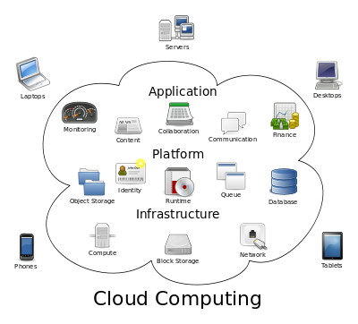
Notes:
IaaS delivers computer infrastructure, typically a platform virtualization environment, as a service. Rather than purchasing servers, software, data center space or network equipment, clients instead buy those resources as a fully outsourced service.
PaaS deliver a computing platform where the developers can develop their own applications.
SaaS is a model of software deployment where the software applications are provided to the customers as a service.

Slide 140
Layers
Infrastructure cloud
Content cloud
Information cloud

Slide 141
Infrastructure cloud
IaaS
It consists of the physical assets — servers, network devices, storage disks, etc.
Rather than purchasing servers, software, data center space or network equipment, clients instead buy those resources as a fully outsourced service.
. Infrastructure as a Service (IaaS) has providers such as the IBM® Cloud delivers computer infrastructure, typically a platform virtualization environment, as a service.

Slide 142
Content cloud
It provides the application infrastructure. Platform as a Service (PaaS) provides access to operating systems and associated services. It provides a way to deploy applications to the cloud using programming languages and tools supported by the provider.
PaaS has providers such as Amazon's Elastic Compute Cloud (EC2).

Slide 143
Information cloud
The top layer is the application layer, the layer most visualize as the cloud. Applications run here and are provided on demand to users. - SaaS (Software as a service)
Software as a Service (SaaS) has providers such as Google Pack. Google Pack includes Internet accessible applications, tools such as Calendar, Gmail, Google Talk, Docs, and many more.

Slide 144
Clients

Slide 145
Deployment models
Private cloud,
Public cloud,
Community cloud and
Hybrid cloud

Slide 146
Issues
Privacy, Compliance, Security,
Sustainability and abuse.

