Slide 1
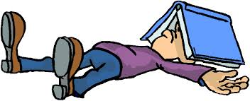
EXAMINATION TECHNIQUES

Slide 2
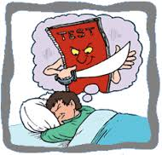
WORD EXAMS MEANS???
Not Again!!
Tension
Fear/ Anxiety
Sleep less nights and days
No games, watching T.V, or going out with friends...

Slide 3
WHY CONDUCT EXAMS
Please remember, NO teacher wants you to FAIL!!
Exams are just a method to evaluate your academic, and mental growth suitability for the next higher class
Exams also ensure that you learn what has been taught to you. Please remember whatever information received now will help you in future...

Slide 4
Why is there exam stress??
Parental Pressure
Pressure of getting good marks
Competitiveness
Pressure of failure/ rejection/ or being left out
Fear of being ridiculed by parents, siblings, friends, neighbours etc.

Slide 5
Why do you forget what you have learnt
Not prepared/studied well
Not revised properly
Not taken appropriate rest and nutrition
Mind full of negative thoughts

Slide 6
Tips to study
Take up the difficult subject first
Try and read through the entire syllabus to find out your strengths and weak areas
Focus on topics in which you are sure you will score, BUT DO read the ones that you find difficult

Slide 7
Tips to study
4) Break the chapter into sub topics yourself. You should be able to remember the contents of the entire chapter.
5) If you are not the one who learns everything by heart... Try this strategy..read the chapter once generally, then read it carefully the second time.. And the third time you will mostly remember the content of the chapter!!

Slide 8
Tips to study
6) Close your eyes and do a mental revision... You should be able to visualise the chapters
7) Don’t get worried by what and how much your friends have studied!!
8)Its not important how many hours you study... What is important is HOW/ WHAT you study. Recreation is important

Slide 9
At the exam centre
Don’t get tensed by what your friends have studied/ or what you have missed out on.. If possible don’t discuss
Just forget about the results of the exams, remove negative thoughts
Take the exam as a challenge to show your academic achievements

Slide 10
When you get the exam paper
Don’t get tensed about what you don’t know…
Concentrate on WHAT YOU KNOW
Of course do the ones which you know the best and write something at least for the ones that you don’t know
Please read/ understand the question carefully “Outline, Compare, Discuss, Short notes” are all different type of questions

Slide 11
When you get the exam paper
You will get marks on what you have answered AND NOT on how much you have studied!!
Try and have a small introduction, the main answer and a conclusion to each of your answers.
A Good Handwriting and Neat Answer Sheet

Slide 12
THANK YOU
Made by :
Bhavna Chibber
PGT comp. sc.

